Slide 1

Chapter 8 – part I

Slide 2
OUTLINE
  Momentum and impulse.
  Conservation of momentum.
  Collisions.

Slide 3

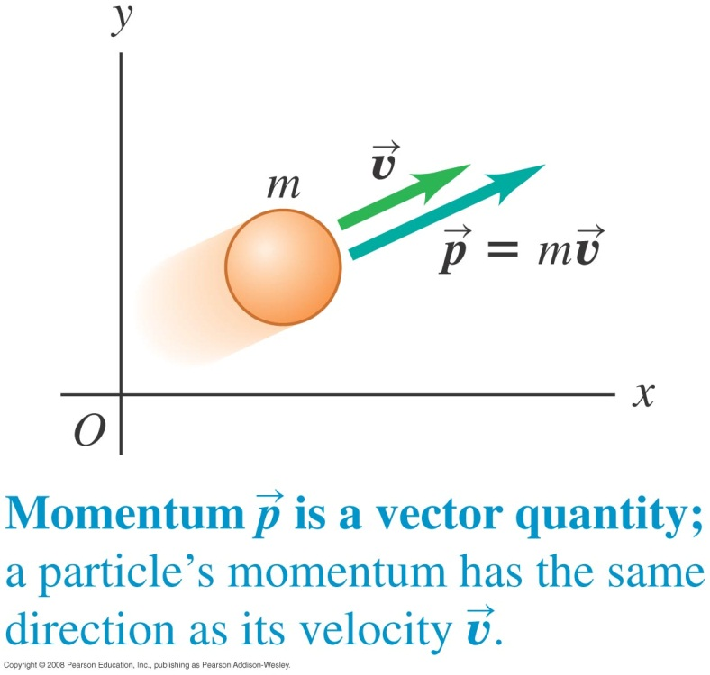
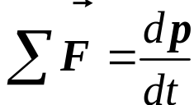
Momentum and Newton’s second law
  The momentum of a particle is the product of its mass and its velocity.
  Newton’s second law can be written in terms of momentum as

Slide 4
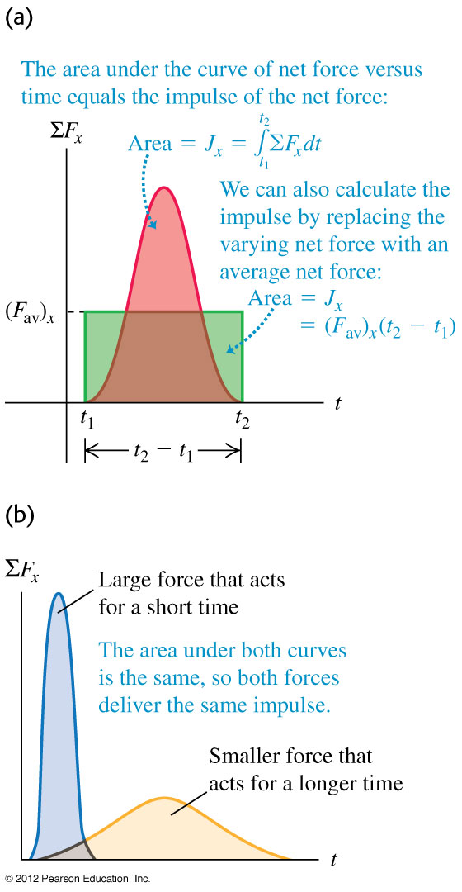
Impulse and momentum
  The impulse of a force is the product of the force and the time interval during which it acts.
  On a graph of ΣF_{x} versus time, the impulse is equal to the area under the curve, as shown in Figure to the right.
  Impulse-momentum theorem: The change in momentum of a particle during a time interval is equal to the impulse of the net force acting on the particle during that interval.

Slide 5
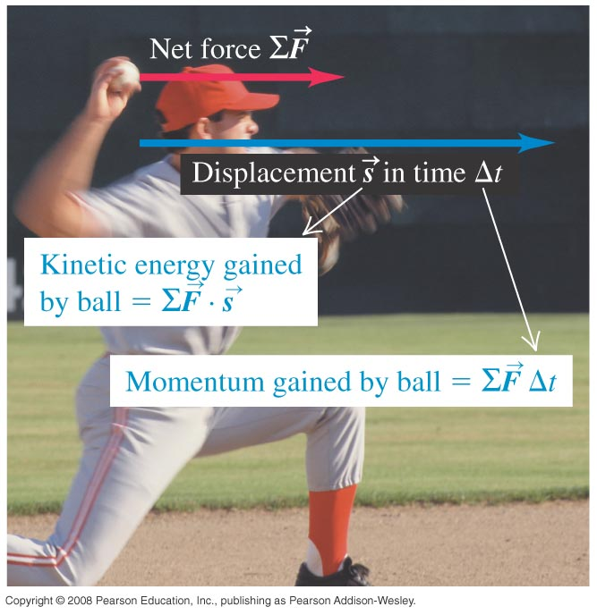
Compare momentum and kinetic energy
  Changes in momentum depend on the time over which the net force acts, but changes in kinetic energy depend on the distance over which the net force acts.

Slide 6
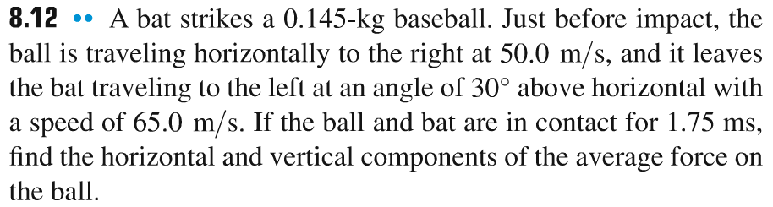
Problem #1

Slide 7
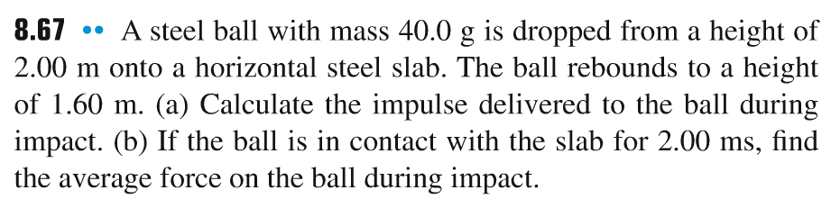
Problem #2

Slide 8
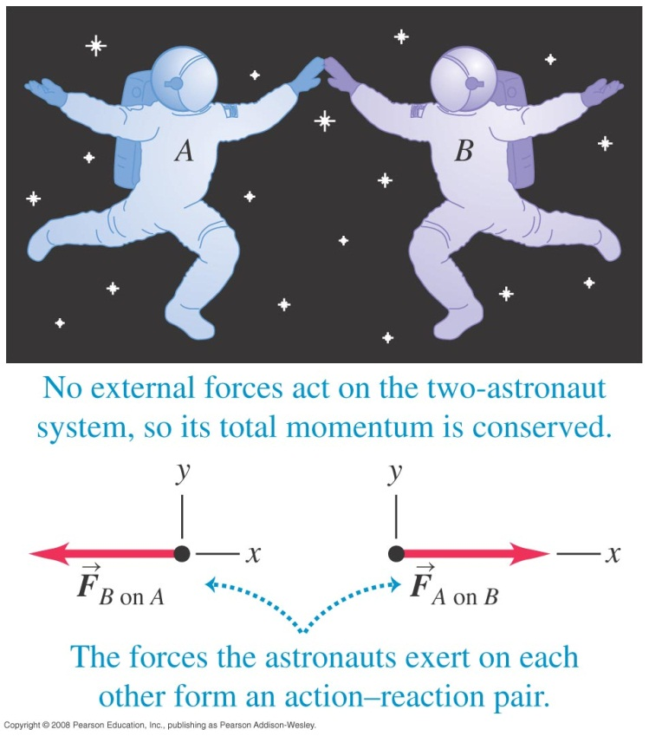
An isolated system
  The total momentum of a system of particles is the vector sum of the momenta of the individual particles.
  No external forces act on the isolated system consisting of the two astronauts shown below, so the total momentum of this system is conserved.

Slide 9
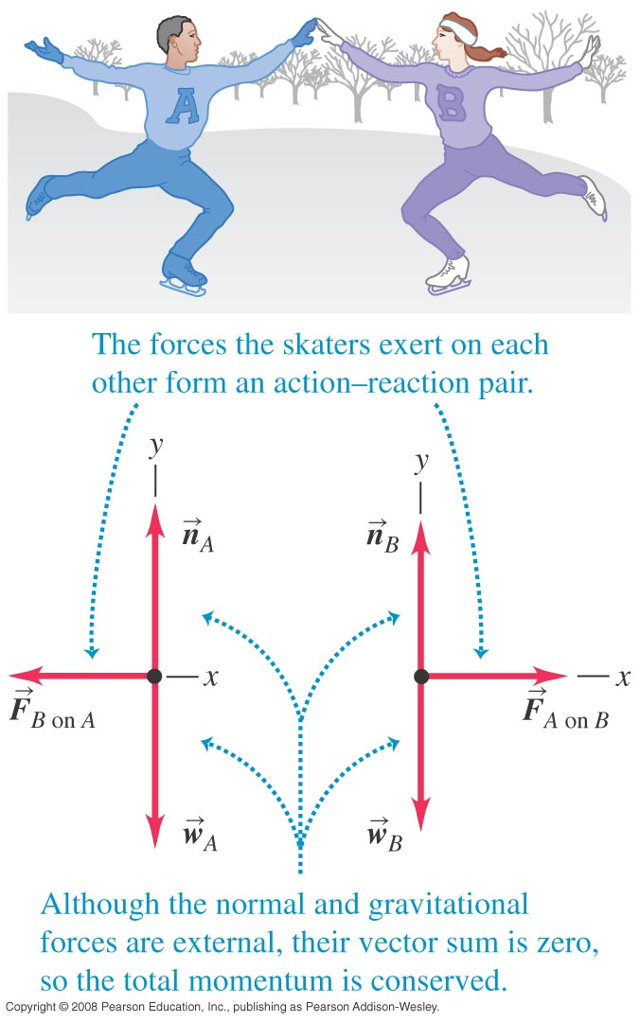
Conservation of momentum
  External forces (the normal force and gravity) act on the skaters shown in Figure at the right, but their vector sum is zero. Therefore the total momentum of the skaters is conserved.
  Conservation of momentum: If the vector sum of the external forces on a system is zero, the total momentum of the system is constant.

Slide 10
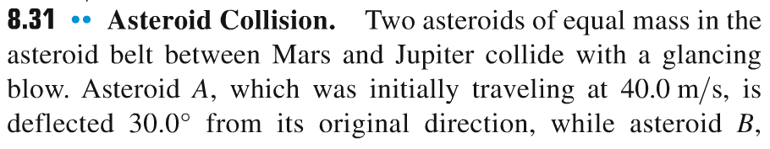
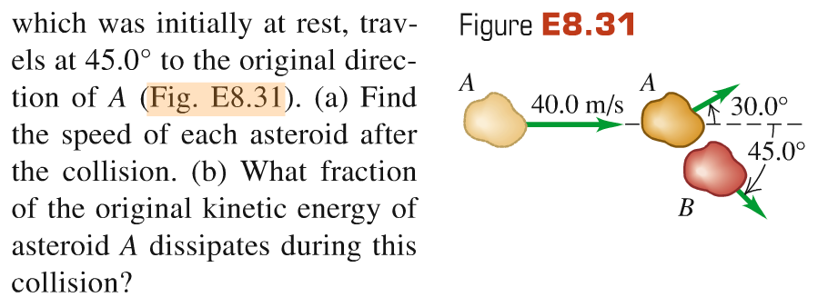
Problem #3

Slide 11
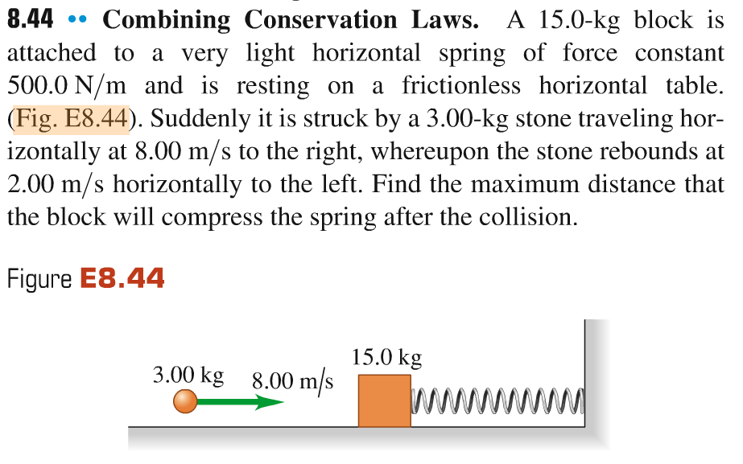
Problem #4

Slide 12
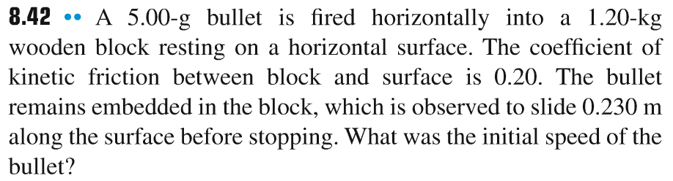
Problem #5

